Slide 1

RUNGTA COLLEGE OF DENTAL SCIENCES AND RESEARCH
Endodontic instruments
DEPARTMENT OF CONSERVATIVE DENTISTRY AND ENDODONTICS

Slide 2
Specific learning Objectives
At the end of this presentation the learner is expected to know ;
Core areas* | Domain ** | Category #
History | Cognitive | Nice to know
Classification of endodontic instruments | Cognitive | Must know
Rubber dam | Cognitive | Must know

Slide 3
Content
Standardization of Instruments given by Ingle and Levine
Classification of Endodontic Instruments
Group I Hand-operated Instruments
Files
Group II Low Speed Instruments with Latch-Type Design
Group III Engine-Driven Instruments
Generations of NiTi Rotary Files
First Generation NiTi Rotary Files
Second Generation
Third Generation Files
Fourth Generation Reciprocating Instruments
Fifth Generation Instruments
Scout Race Files
Group IV Sonics and Ultrasonics in Endodontics
Sonic Handpiece
Instrument Deformation and Breakage
Instruments Used for Filling Root Canals

Slide 4
Do warm Gutta-Percha techniques damage the PDL?
Zach OOO 1965 – Monkey study, effect of temp increase on pulp a. 4 degree – pulps recovered b. 10 degree – 85% recovered; 15% necrotic c. 20 degree – 40% recovered; 60% necrotic
d. >20 degree – none recovered
2. Baumgartner JOE 2001 – This study tested the change in radicular temperature associated with use of System B and Obtura.
At no time did the external root temperature increase more than 10^{O}C.
3. Gutmann JOE 1987 – Confirmed Baumgartner’s study and found
Maximum temperature change from placement of GP with Obtura was 1.1^{O}C.
Noted that 10 degree C change will damage PDL cells.
Temps never reached this high

Slide 5

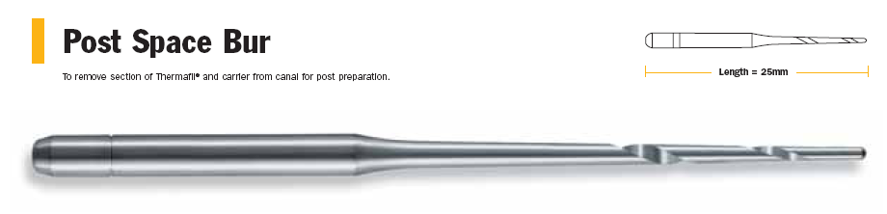
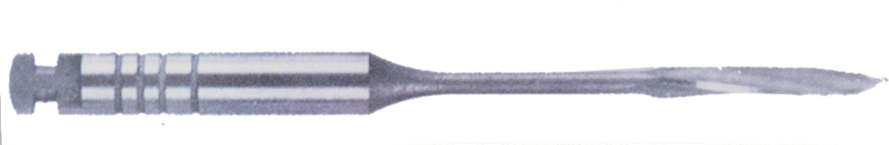
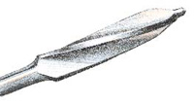
Instruments For Post Space Preparation
Peeso – Reamers
Most often used in preparing coronal portion of the root canal for recieving a post core
Safe−ended
Tip – Diameter: 0.7 – 1.7
Used in a brushing motion

Slide 6
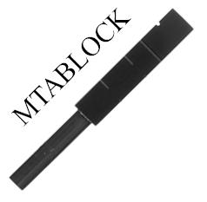
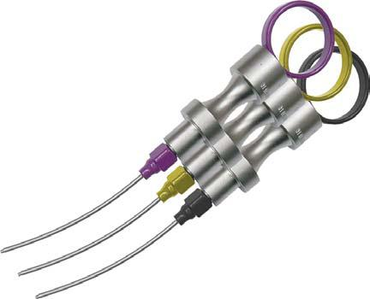
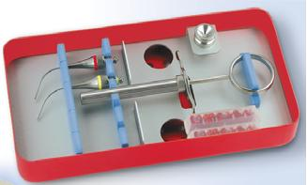
INSTRUMENTS FOR PERFORATION REPAIR
Dovgan’s Carriers

Slide 7
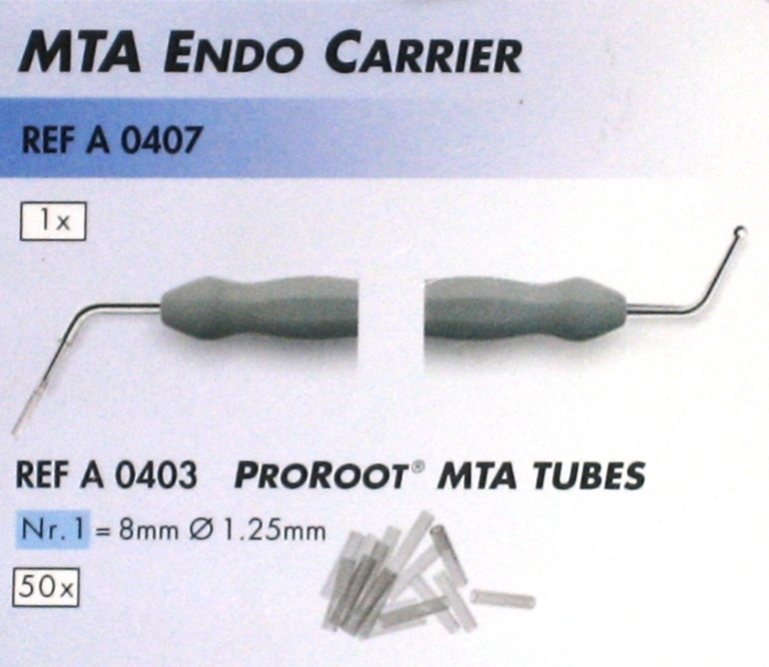
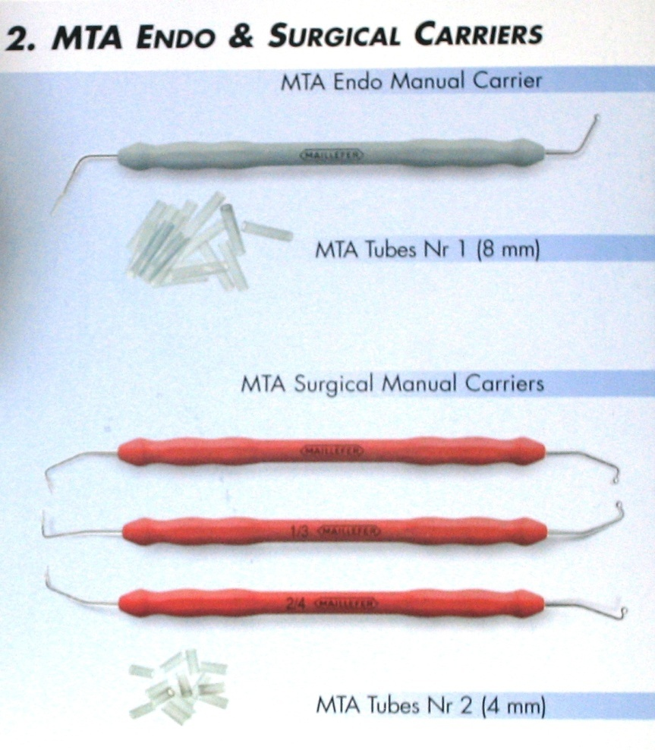
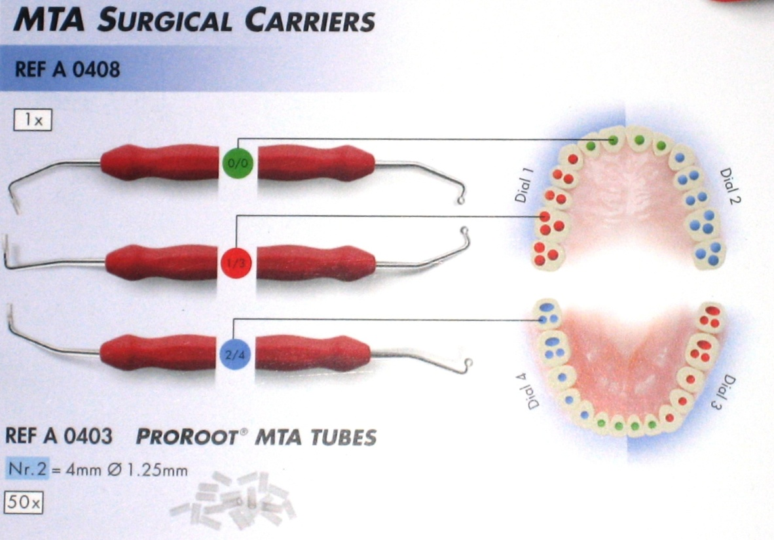

Slide 8
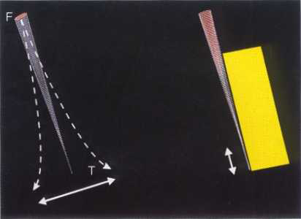
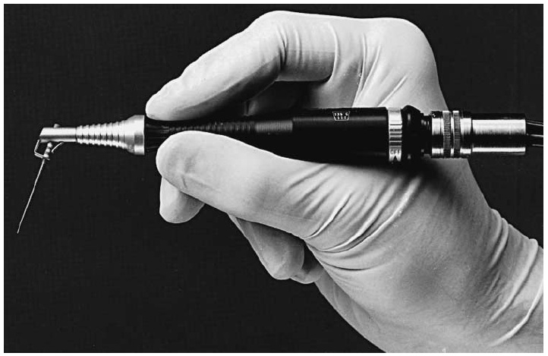
Sonics & UltraSonics
Sonics
Oscillatory range of 1,500 to 3,000 cycles per second

Slide 9
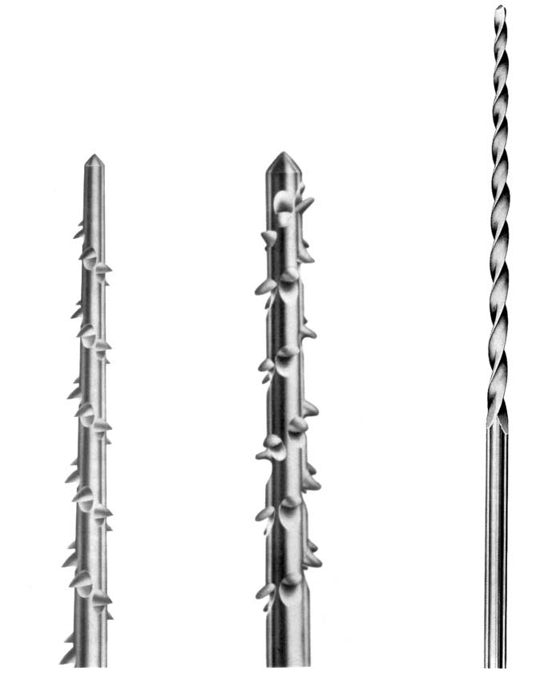
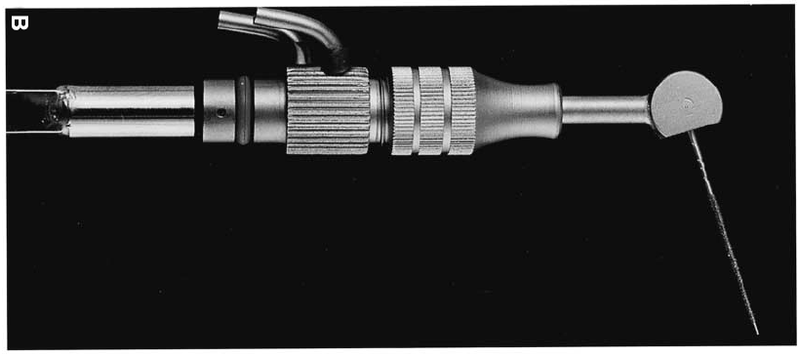
Files used in sonic instruments.
Heliosonic File
(Based On A Triple File),
The Characteristic Shaper File
The Rispisonic File.

Slide 10
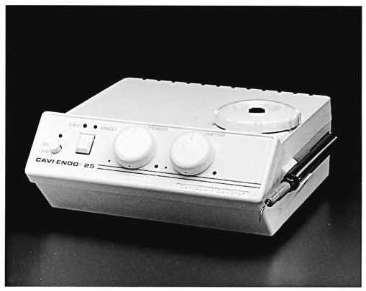
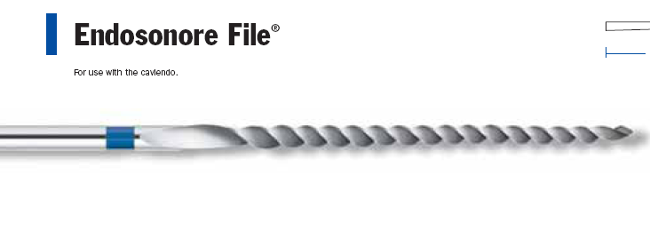
Ultrasonics
Richman (1957) 1st use of ultrasonics in endodontics
Martin and Cunningham were the first to develop a device, test & market it as the CAVI ENDO
CAVI-ENDO

Slide 11
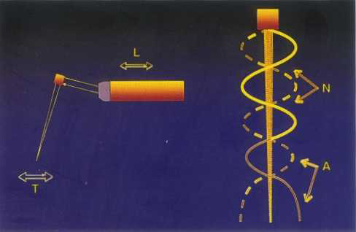
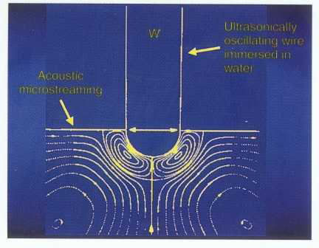
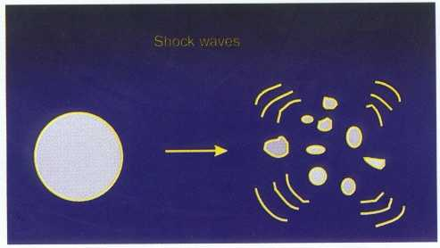
Ultrasonics
Cavitational Activity
Acoustic Streaming

Slide 12
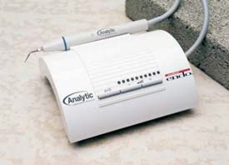
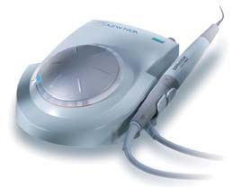

Slide 13
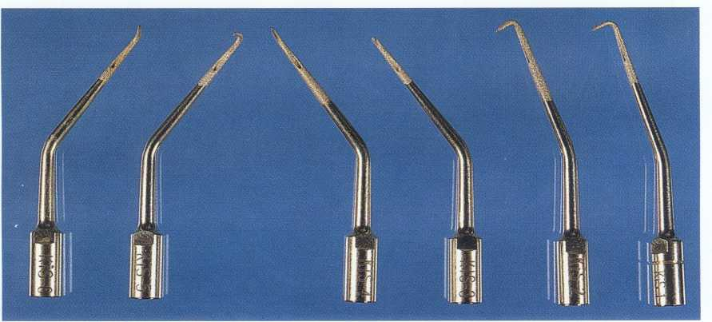
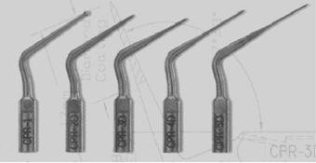
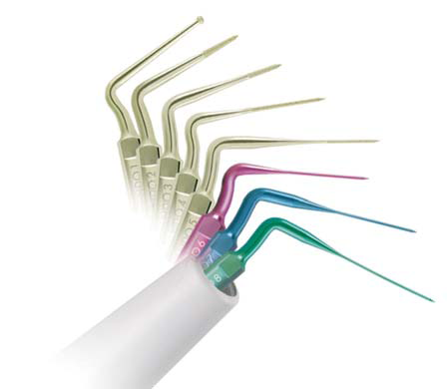
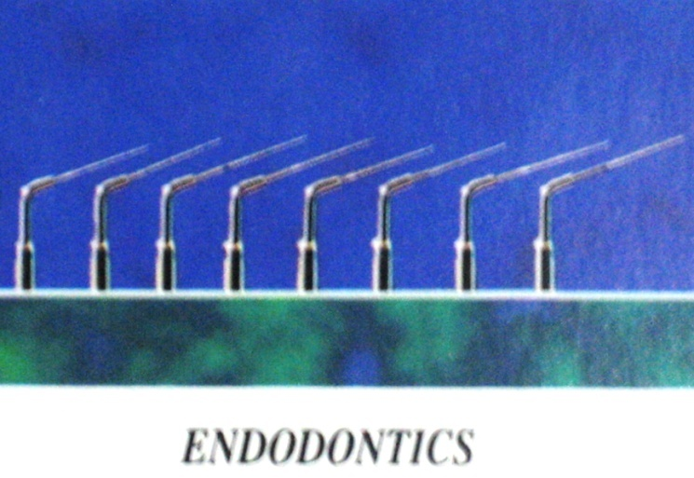
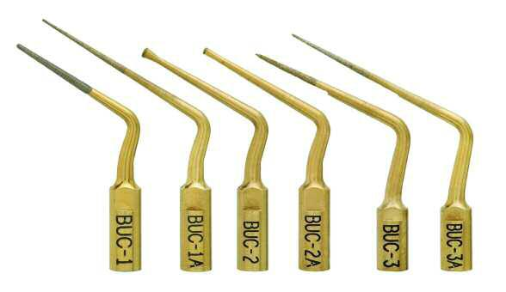
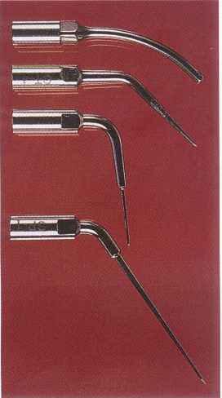
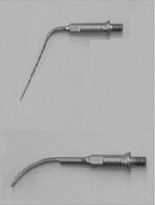
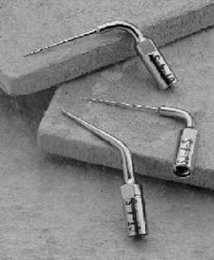
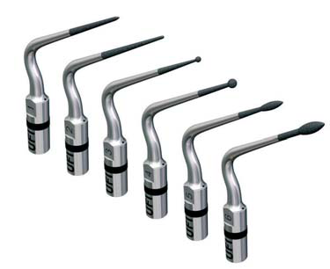
Ultrasonic Tips

Slide 14
Components of the different ultrasonic systems have been broadly classified as follows:
(1) Access Refinement Tips
(2) Vibratory Tips
(3) Bulk Removal Tips And
(4) Troughing Tips.

Slide 15
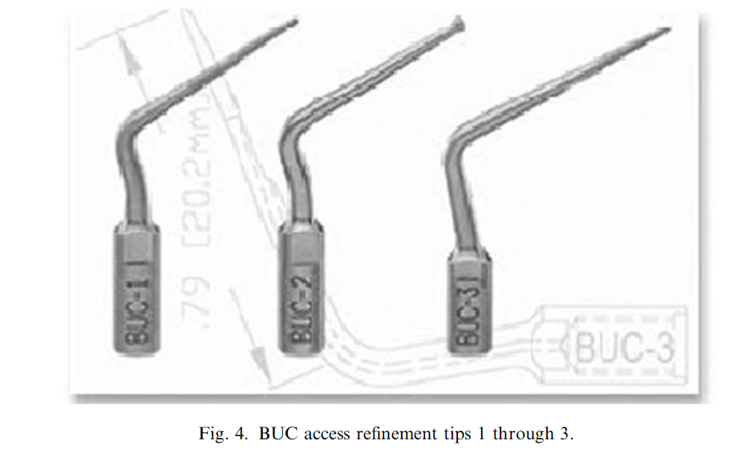
Access refinement tips
Advantages:
There is no handpiece head to obscure vision and,
Direct Access & Vision
Size of ultrasonic tips is smaller than the smallest burs; therefore, the dentine can be brushed off in smaller increments and with greater control.
The process allows for exposure of any missed or hidden canals or recesses containing necrotic pulp tissue without gutting down the tooth structure

Slide 16
Vibratory tips
The VT (Sybron Endo), Osada Enac ST09, and CPR 1 are examples of such instrument tips.
The tips of these instruments are spherical or flat and are placed against the post to transmit vibration.
Activated at maximum intensity and moved circumferentially

Slide 17
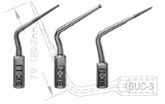
Bulk removal tips
Bulk removal tips are extremely sharp and sturdy tips that are operated at moderate or maximum intensity of the ultrasonic unit.
Eg. BUC 1 and CPR 2D
Designed primarily to remove dentine and core material quickly and expeditiously before subjecting the root canal obstruction to vibratory or troughing procedures.

Slide 18
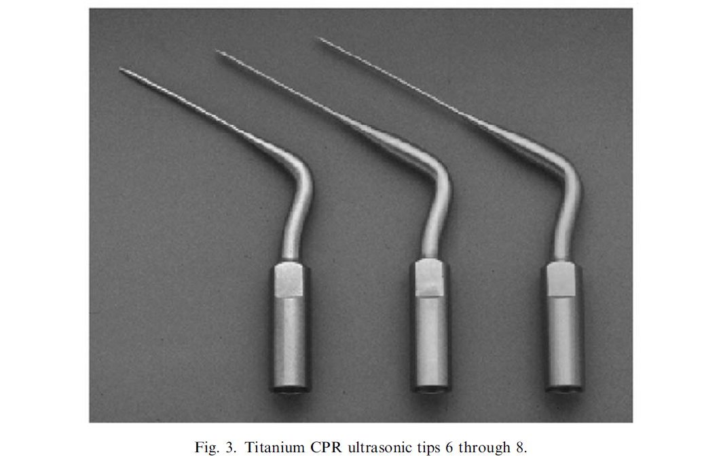
Troughing tips
Troughing tips are used to create a sufficiently deep trough around posts to maximize the benefits of subsequently applied vibratory or extraction forces.
Initially, the troughing is performed with instruments such as CPR 3D, 4D, and 5D, which are 15, 20, and 25 mm in length
coronal, middle, and apical one third of root canals.
The BUC 3 (Obtura/Spartan, Fenton, Ohio) or CT 4 tip (Sybron Endo), which also is available with a diamond coating, can be used for this purpose.

Slide 19
Non-Surgical Endodontic Retreatment
Gutta Percha Removal
Post Removal
Instrument Removal

Slide 20
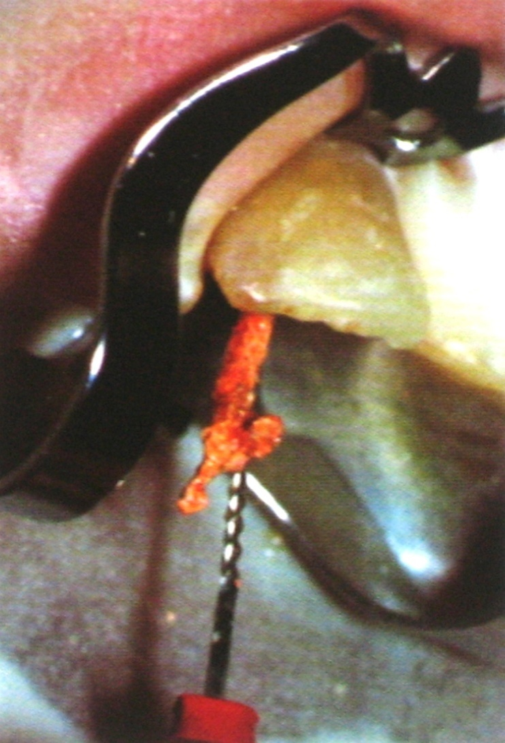
Gutta Percha Removal
Engaging an Endodontic File
Softening with chemicals
Use of Rotary Instruments

Slide 21
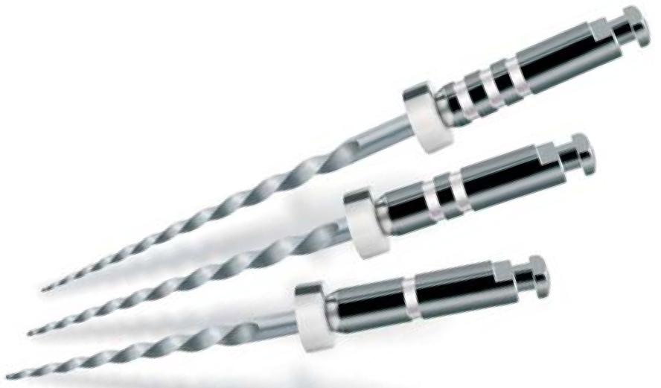
Protaper Retreatment Files
D1
D2
D3

Slide 22
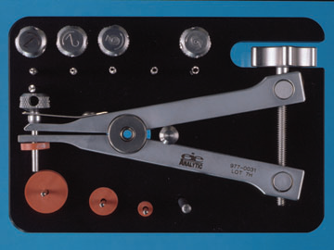
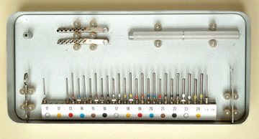
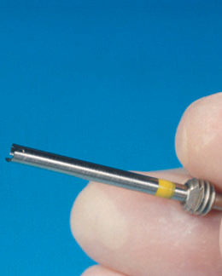
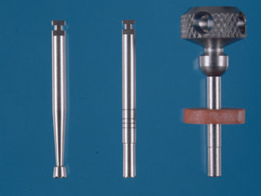
Post Removal Systems
Ruddle Post Removal Kit
Masseran Kit
Domer Bur, Trepan And Tap
Masseran Trephan

Slide 23
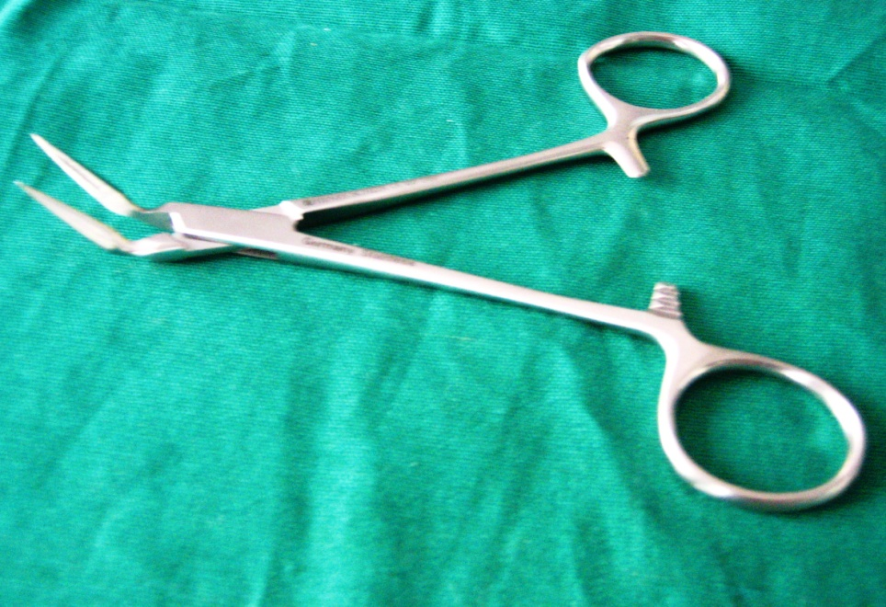
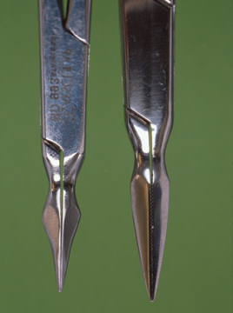
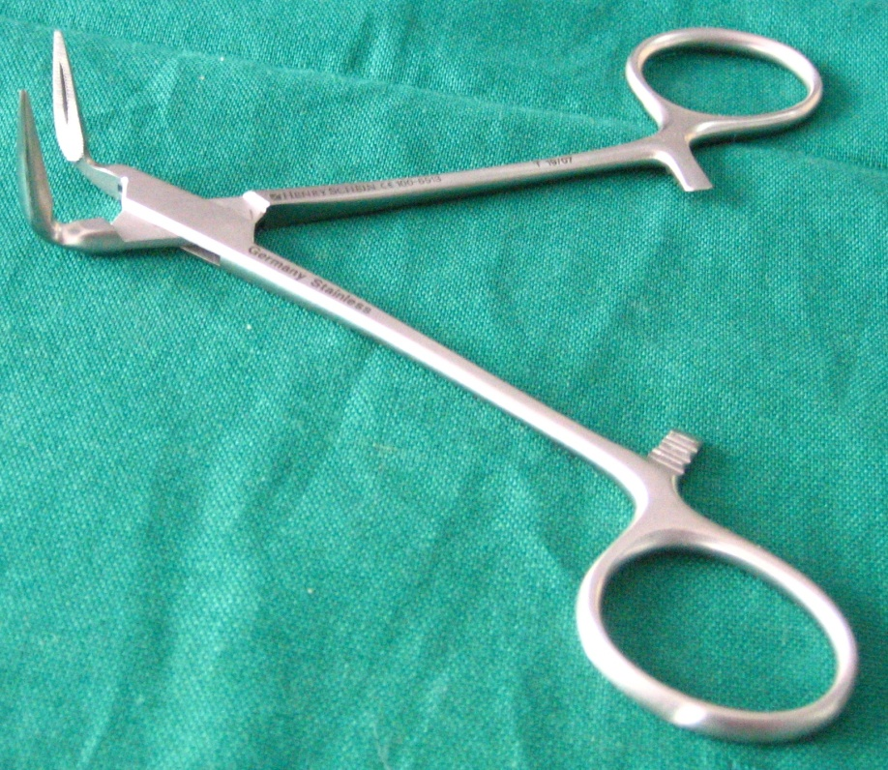
Steiglitz Forceps
Modification of the tip for
ease of access

Slide 24

LN Burs
For access around posts & separated instruments (0.06)

Slide 25
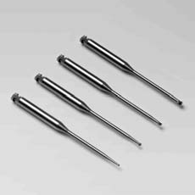
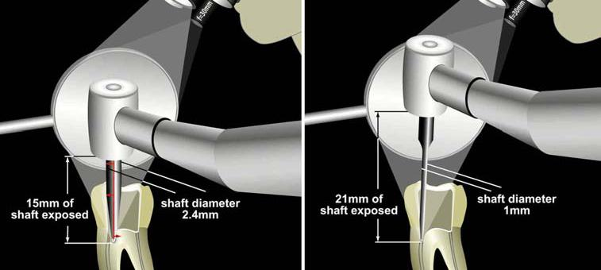
MUNCE DISCOVERY BURS
34mm-long Round Carbide-tipped Troughing Burs
Stiff Shafts That Are 1mm In Diameter.
Available In 4 Sizes: #1/2, #1, #2 And #4.

Slide 26
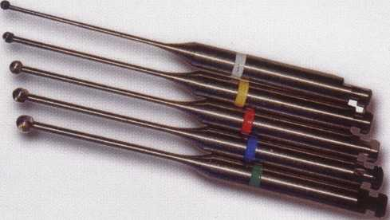
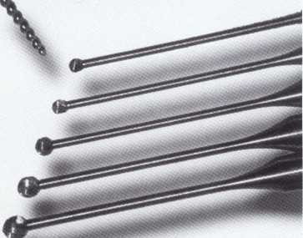
Mueller burs
Tip of #70 file.
Smallest 0.9mm

Slide 27
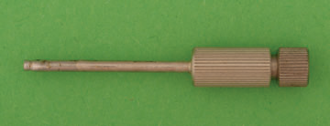
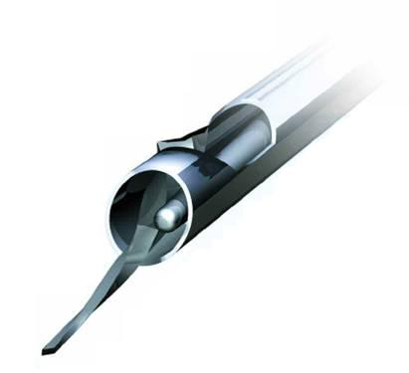
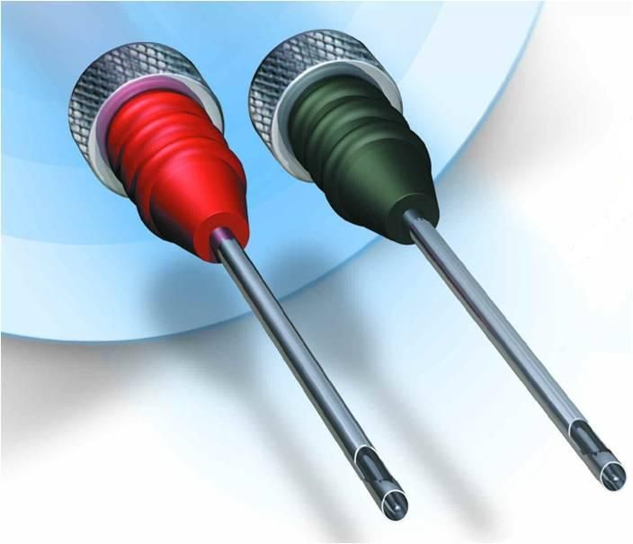
DEVICES FOR BROKEN INSTRUMENT REMOVAL
Masseran Instrument retrieval system
IRS

Slide 28
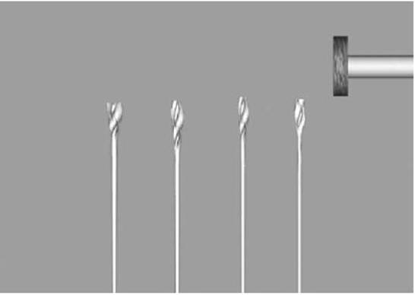
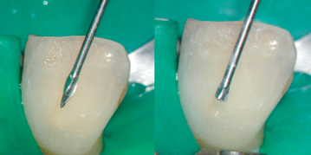
MODIFICATION OF CONVENTIONAL INSTRUMENTS FOR INSTRUMENT REMOVAL
Modified GG Drills
Modified LightSpeed Instruments

Slide 29

Cancellier Tubes
Can be used withsuperglue to help remove fractured instruments

Slide 30
Instrument Sterilization
Contaminated endodontic files in general practice A study of visual and blood contamination on reprocessed endodontic files from general dental practice
This study demonstrates that endodontic files are
not reliably decontaminated by methods currently employed in dental practice.
British Dental Journal (2005); 199, 513
S. Letters, A. J. Smith, S. McHugh and J Bagg

Slide 31
Groups were "sterilized" by
Glutaraldehyde Immersion,
Steam Autoclaving,
Various Techniques Of Salt Sterilization.
Only proper steam autoclaving reliably produced completely sterile instruments.
Salt sterilization and glutaraldehyde solutions may not be adequate sterilization methods for endodontic hand files and should not be relied on to provide completely sterile instruments.
The sterilization of endodontic hand files. J Endod. 1996 Jun;22(6):321-2.
HurttCA; RossmanLE

Slide 32
Influence of sterilization on mechanical properties and fatigue resistance of nickel-titanium rotary endodontic instruments.
Changes in the mechanical properties of Ni-Ti endodontic instruments after five cycles of commonly used sterilization procedures were insignificant.
The sterilization procedures are safe as they produced a significant increase in the fatigue resistance of the instruments
IEJ Volume 39, Number 9, September 2006 , pp. 709-715
Viana, A.; Gonzalez, B.; Buono, V; Bahia, M.

Slide 33

TAKE HOME MESSAGE
From a biological perspective, root canal treatment is directed toward the elimination of micro-organisms from the root canal system and the prevention of reinfection.
Technological advances in the form of rotary NiTi instruments have led to dramatic improvements in the ability to shape root canals with potentially fewer procedural complications.

Slide 34
QUESTIONS
Instruments used for GP removal .
Do warm Gutta-Percha techniques damage the PDL?

Slide 35
REFERENCES
Endodontic Practice 11th Edn. Grossman
Pathways Of The Pulp 6th Edn. & 9th Edn. Cohen
Endodontics Vol 1 Arnaldo Castellucci
Endodontics Ingle 5th Edn.
Text book of Endodontology Bergenholtz Reitz
Endodontic Therapy Weine 5th Edition
Color atlas of Endodontics William Johnson
Principles and practice of Endodontics- Walton &Torabinejad
Color Atlas of Microsurgery in Endodontics Syngcuk Kim
Textbook of Endodontics Nisha Garg Amit Garg

Slide 36
THANKYOU

